Slide 1

Digital Forensics Project
By Group 33
(Raminta, Michael, Luke, Ross, Jamie, Ryan)

Slide 2
Overview of the Project
Deliver a forensic image of suspicious activity for people to analyse and discover facts about made up people in a believable scenario where digital forensics would help with an investigation
Two characters Created – John , Vicky
Communications and Organisation - Trello, Google Drive, Discord
Implementation - 5-6 weeks

Slide 3

Roles and Responsibilities
Raminta – PM
Michael – Forensic Image Analyser
Luke – Keylogger Developer
Jamie – Website Creator
Ross – Email researcher
Ryan – Email Background Noise

Slide 4
Keylogger
The keylogger is a piece of code which records keystrokes when a user types data using their keyboard.
This piece of software can be used in malicious ways if in the wrong hands. In this case John used this on Vicky's machine by hiding the logger files (hidden) and making a executable which looked like Internet explorer and Thunderbird.

Slide 5
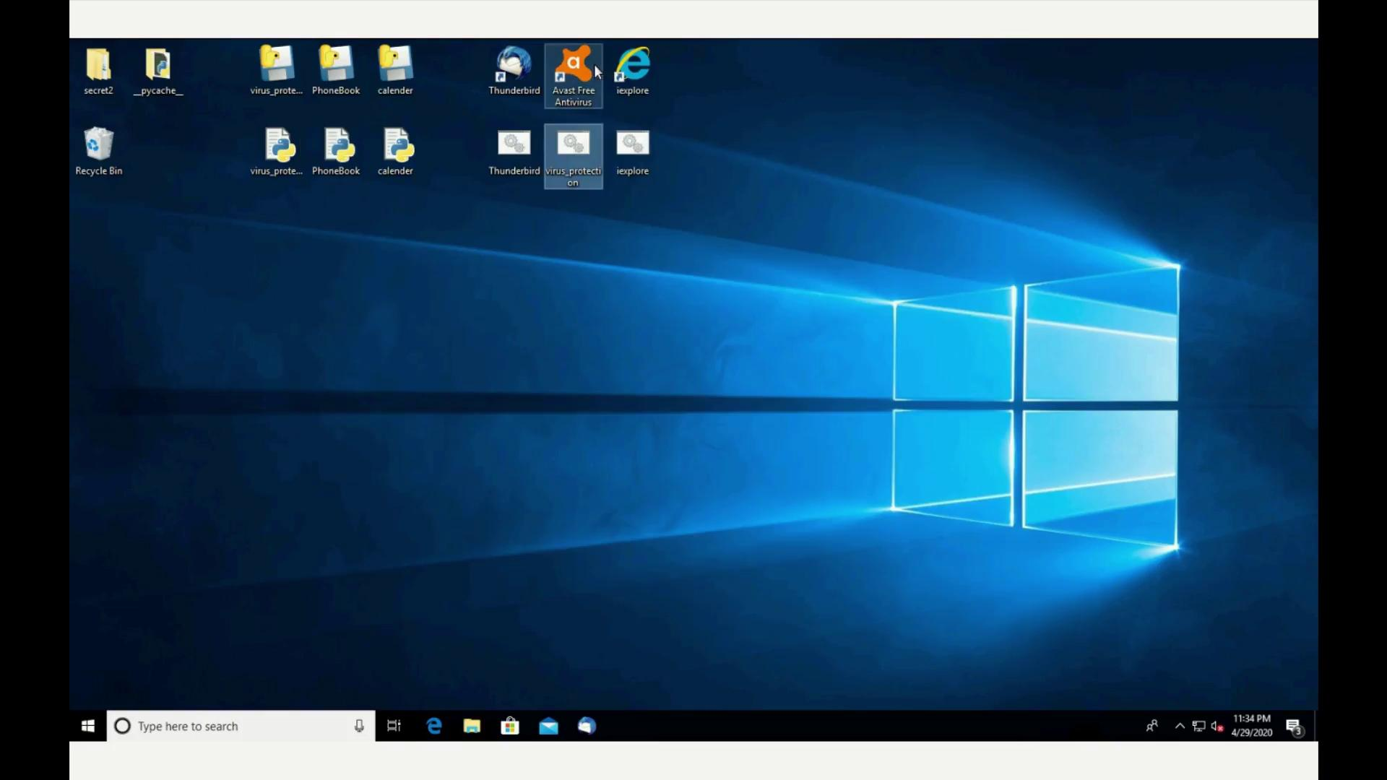
Keylogger
The keylogger is a piece of code which records keystrokes when a user types data using their keyboard.
This piece of software can be used in malicious ways if in the wrong hands. In this case John used this on Vicky's machine by hiding the logger files (hidden) and making a executable which looked like Internet explorer and Thunderbird.

Slide 6
Bank Site
Web server made with Node.JS made to look like a real bank site.
Users are able to create an account, log in and move money in and out of their account. All usage of the site is stored in a log file, which in a real life scenario would allow the bank to monitor any malicious activity on their site.

Slide 7
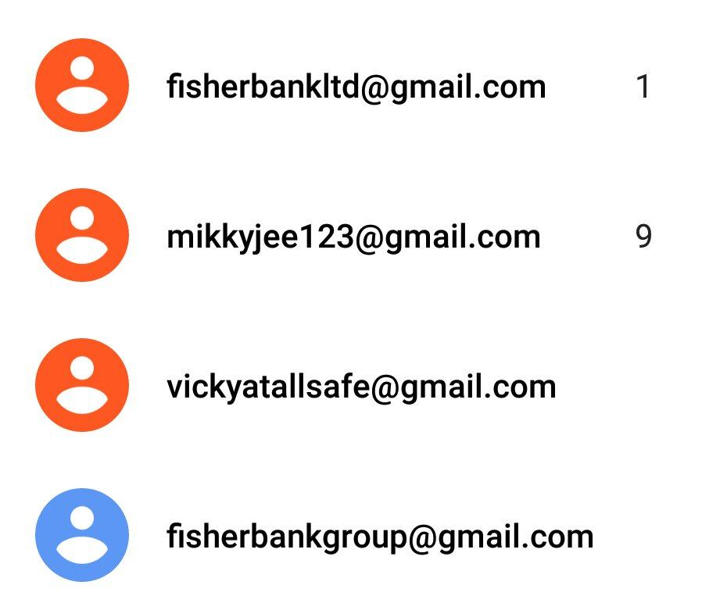
Emails
Fisherbankltd - real bank email
Mikkyjee123 - johns personal email
Vickyatallsafe - vickys work email
Fisherbankgroup - johns fake bank email

Slide 8
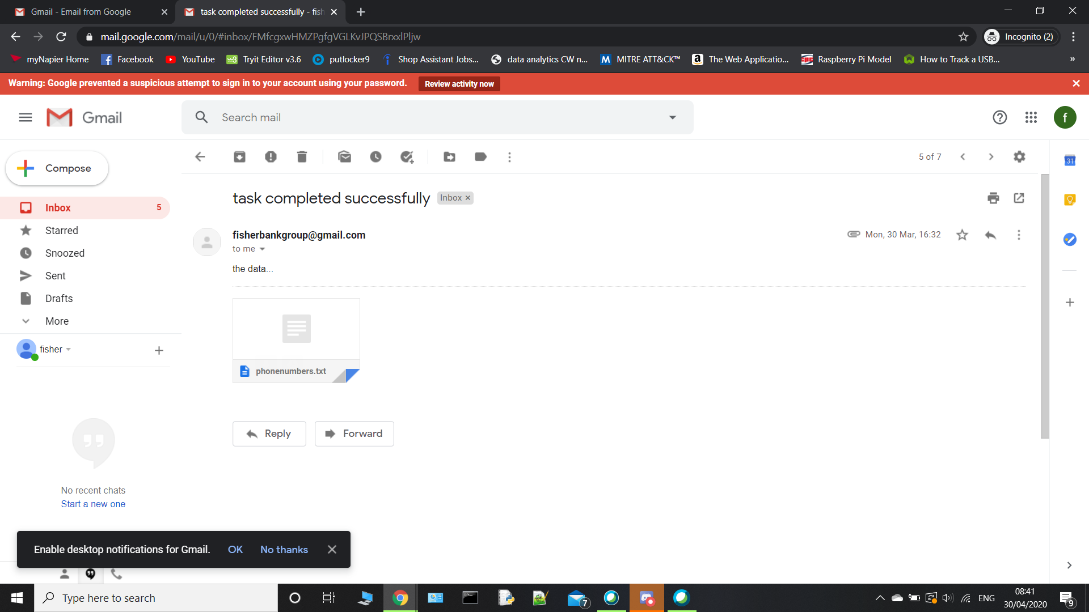
Emails

Slide 9
The Forensic Image Analysis

Slide 10
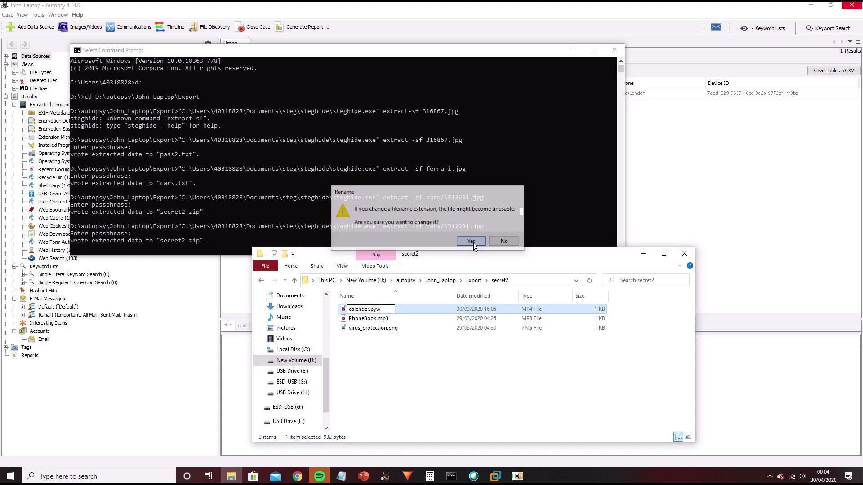

Slide 11
Thanks For Listening
Any Questions?

